Slide 1
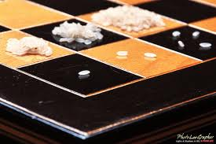
Sum of terms in geometric sequence
When the creator of the game of chess showed his invention to the ruler of the country, the ruler was so pleased that he gave the inventor the right to name his prize for the invention.
The man, who was very clever, asked the king this: that for the first square of the chess board, he would receive one grain of rice, two for the second one, four on the third one, and so forth, doubling the amount each time.
The King agreed, thinking that it was
a very good offer. How many grains
of rice did the man obtain from the
King?

Slide 2
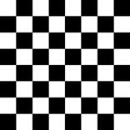
Sum of terms in geometric sequence
If one gram of rice is on the 1st square of a chessboard, 2 on the 2nd square, 4 on the 3rd square, 8 on the 4th square etc…
How many grams of rice are there?

Slide 3
Sum of terms in geometric sequence
Add up all terms from 1 to 64
s = 1 + 2 + 4 + 8 + 16 + …

Slide 4
Sum of terms in geometric sequence
Add up all terms from 1 to 64
s = 1 + 2 + 4 + ..
s = 2⁰ + 2¹ + 2² + ... + 2⁶³

